Slide 1
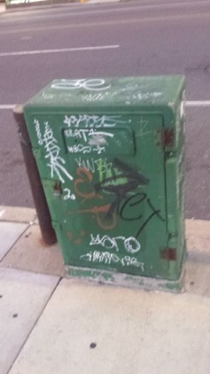
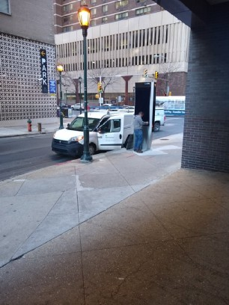
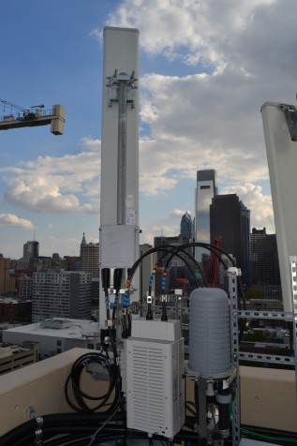
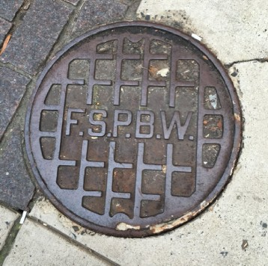
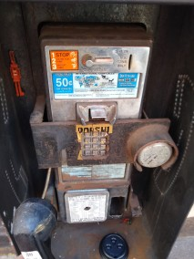
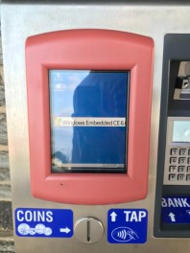
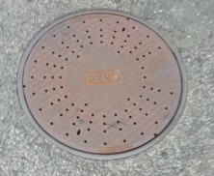
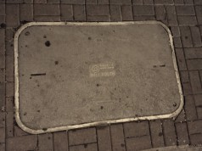
Networks of Philly (v2)
Philadelphia’s Hidden Network Infrastructure

Slide 2
Table of Contents
Who Am I?
How did this all start?
Infrastructure! (Manholes, handholes, antennae, misc.)
Sightseeing (Buildings of networking importance)
Right To Know Requests
What’s next?
Questions!

Slide 3


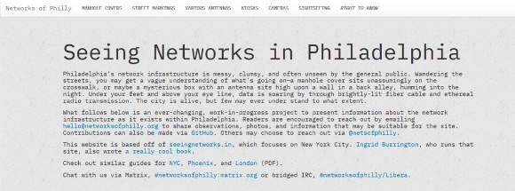
Who am I?
Not an expert in anything, but really like networks.
May have met me at Philly 2600.
Editor of the N-O-D-E zines.
Run networksofphilly.org

Slide 4
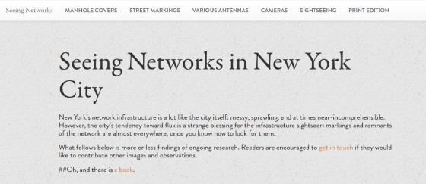
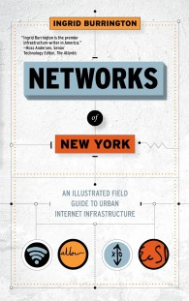
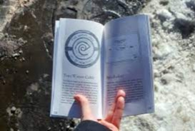
How did this start?
Ingrid Burrington’s Book, Networks of New York: An Illustrated Field Guide to Urban Internet Infrastructure (2016)

Slide 5
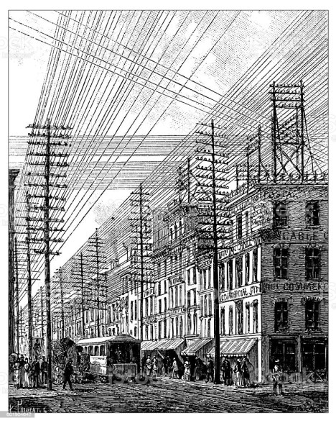
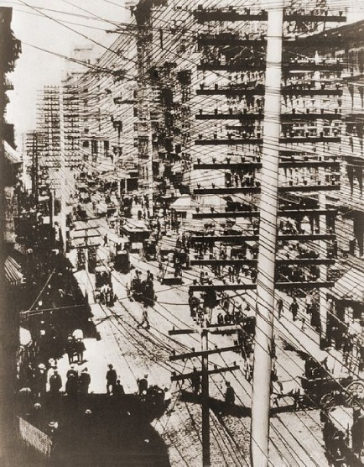

Slide 6
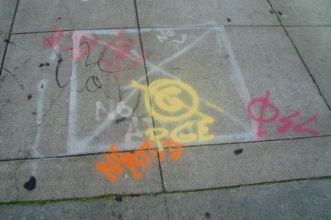
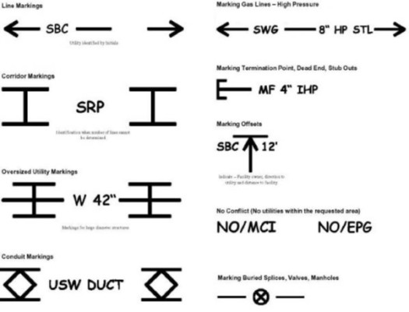
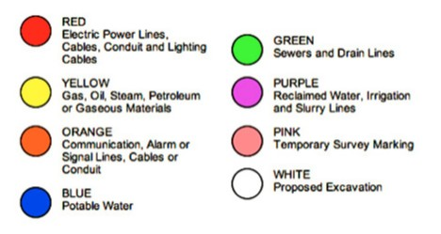
Look at the ground a lot

Slide 7
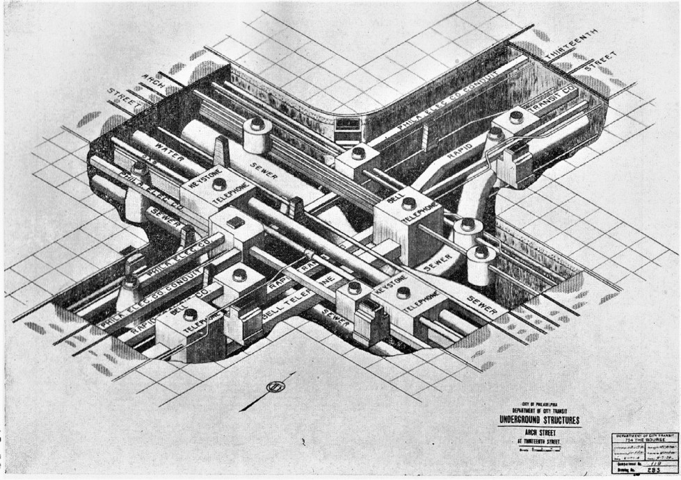

Slide 8
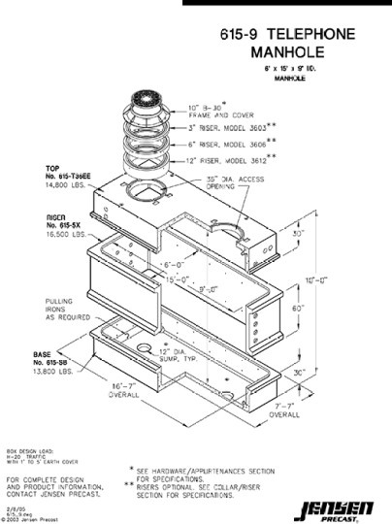
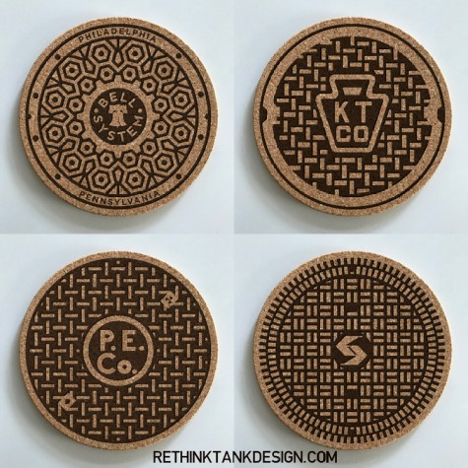
Manholes

Slide 9
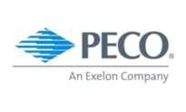
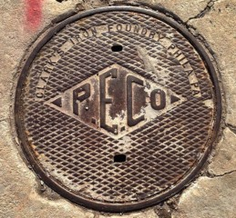
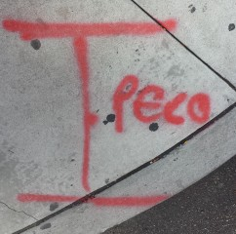
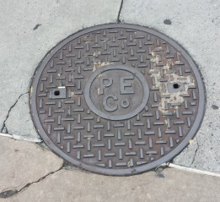
PECO
Formerly Philadelphia Electric Company, founded 1881.
Owns 1,607 miles of high-voltage transmission lines, 15,250 square miles of underground distribution cable, and 12,933 miles of aerial distribution lines.
Part of Exelon as of 2000.

Slide 10
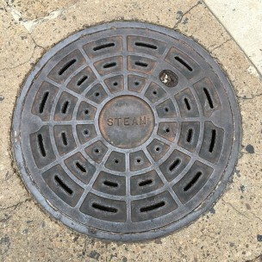
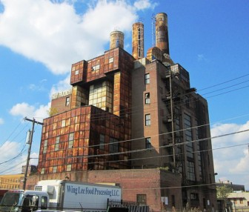
Steam
System dates back to 1889 when a power station at 908 Sansom used exhaust to heat nearby 917 Walnut St.
Third largest steam system in the United States.
Steam runs through pipes at 450F to 162 customers.
Now owned by Vicinity Energy, previously Veolia, Trigen, PECO.

Slide 11
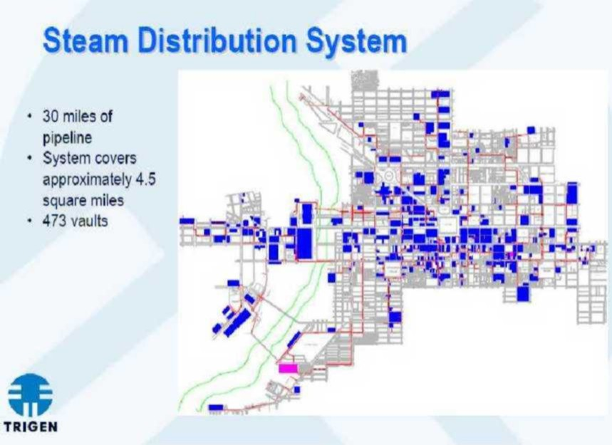

Slide 12
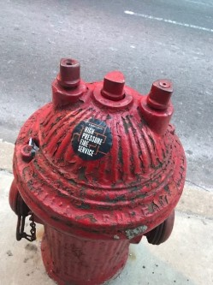
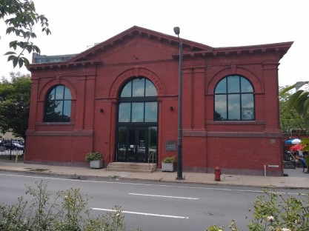
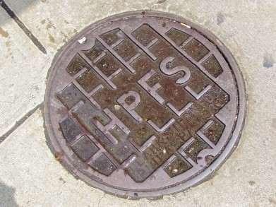
High Pressure Fire Service
HPFS started 1903 as a better way to fight fires.
Could shoot a two-inch stream 230 feet vertically at 400 PSI.
Red hydrants with two independent gates, weighting 1000lbs.
The 56-mile system was decommissioned in 2005 due to disrepair.

Slide 13
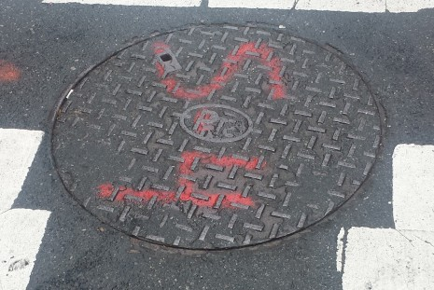

Philadelphia Transportation Co
Main public transit operator from 1940 to 1968.
Replaced Philadelphia Rapid Transit Company (PRT) founded in 1902, now replaced by SEPTA.

Slide 14
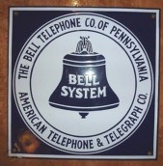
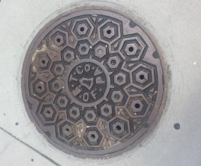
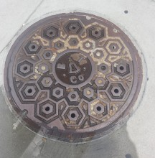
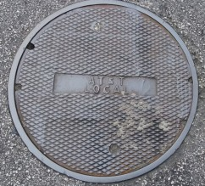
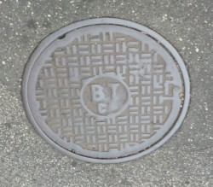
Bell Telephone Company
Bell Telephone Company began as a company in 1879.
Bell Telephone Company of Pennsylvania started the same year.
Bell was broken up in 1984, Philly’s RBOC became Bell Atlantic.

Slide 15
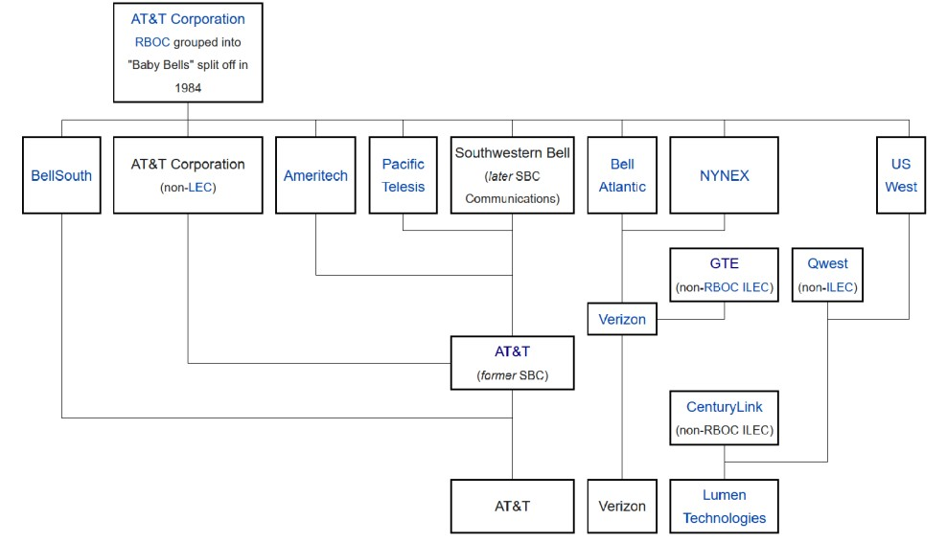

Slide 16
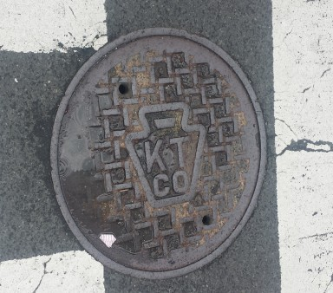
Keystone Telephone Company
Founded 1900 as a direct competitor to Bell Telephone Company, bought by Bell in 1945.
First telephone company in the world to have completely buried wires.
Catered to businesses.
Used for city communications.

Slide 17
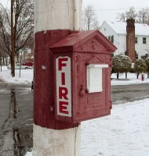
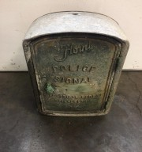
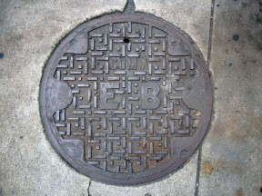
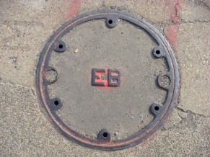
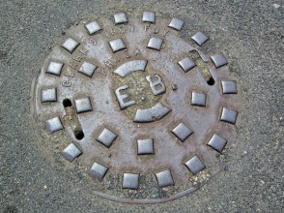
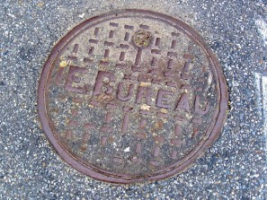
Electrical Bureau
City department from 1856 – 1951.
Maintained communications systems (call boxes) for police and fire.
Now Communications group within the Department of Public Property.

Slide 18

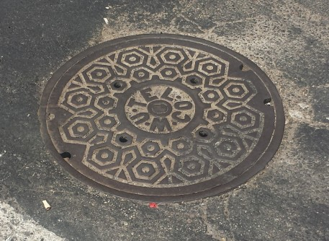
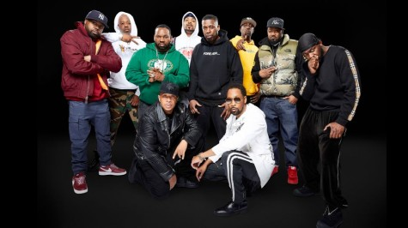
Western Union Telegraph Co
Began operation in 1851.
Telegraphy was spun off to Western Union International in 1963.
Sold telegraphy system to MCI in 1983.

Slide 19
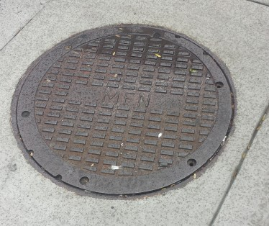
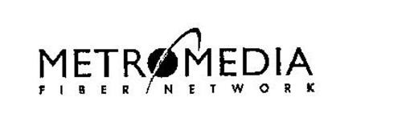
Metromedia Fiber Network
Launched in 1993 as National Fiber Network.
Dark fiber to communications carriers in the U.S. and EU.
Bankrupt by 2002, back in 2003 as Abovenet, bought by Zayo in 2012.

Slide 20
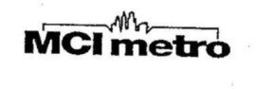
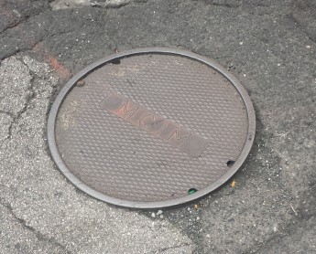

MCI Metro
Division of MCI that layed fiber in the ‘90s.
Bought by WorldCom in 1998.
MCI Acquired by Verizon Communications in 2006 after bankruptcy.

Slide 21




Level 3 Communications
Started building nation-wide fiber in 1998.
Received $411 million from the DOD in 2012.
Bought by CenturyLink in 2017, now Lumen Technologies.
Tier 1 Network Operator.

Slide 22

What the Internet Looks Like

Slide 23


Telephone & Communication
“Telephone” is likely a replacement.
“Communication” is for private cables.

Slide 24


Handholes and Boxes

Slide 25



CATV
Cable TV is a Pennsylvania first.
Handholes provide cable services (coax) to buildings.
Cable television came to Philadelphia in 1983 under 3 franchises: Comcast, Cablevision Systems of Philadelphia, and Philadelphia Inner City Cable (Wade Cablevision came in 1987).

Slide 26


Slide 27



Traffic
Seen on the sidewalk corners near crosswalks.
Cabling here connects traffic lights to large metal control (SCADA) boxes nearby.
Adaptive Traffic Control Systems

Slide 28


Bell Atlantic
Operated 1984 – 2000 as one of the 7 RBOCs.
Was parent of of New Jersey Bell, Bell of Pennsylvania, Diamond State Telephone, and the C&P Telephone companies.
At its peak, it was the second largest telephone company in the USA with operations in 23 countries and 13 states.

Slide 29





Verizon
Carries telephone and Internet services within Philadelphia and is the current telephone provider for the city.
Formed in 2000 after merger between Bell Atlantic and GTE.

Slide 30



Zayo
Founded in 2007, is a fiber network with 130,000 route miles of fiber laid in North America.
Tier 1 Network Operator.
Also work installing small cells.

Slide 31

Antennae & Other Devices

Slide 32




Small Cell
Low-powered cellular radio access nodes.
Range of 10 meters to a few kilometers.
Crown Castle installs Fiber and Small Cells in the North East, bought Lightower, a northeastern network provider in 2017.

Slide 33


Crown Castle (Continued)

Slide 34

Distributed Antenna Systems
Expand cell coverage, adding capacity in under-serviced areas.
Repeater vs Active
Usually cover different frequencies and different carriers.
These units are manufactured by JMA Wireless.

Slide 35

LinkPHL
Provide free WiFI access, mobile device charging, phone calls, access to municipal/emergency services, maps, directions.
Each LinkPHL kiosk has three cameras, and microphones, among other sensors.
Created by Intersection (formerly Titan), with investment from Alphabet.

Slide 36


LinkPHL

Slide 37

Police Cameras
Have been in the city since 2009, many are thought to be broken and in disrepair.
Cameras automatically follow movement. Anyone watching?

Slide 38




Payphones
Pacific Telemanagement Services (PTS) based out of California.
NewTel based out of The Bronx, NYC bought remaining Verizon payphones in 2012.
Please dial the MCI ANAC -> 1-800-444-4444

Slide 39


Slide 40


Not Yet Covered
Parking Kiosks
Transit Kiosks
Shotspotters
Ricochet (anything left?)
More?

Slide 41


Sight Seeing

Slide 42

401 N Broad
Terminal Commerce Building, this 14-story concrete building was built between 1929 and 1931 by the Reading Company.
Largest carrier hotel within Philadelphia with over 80 carriers as of 2015.

Slide 43



Three Logan Square
Formerly the Bell Atlantic Tower, this 55-story office building was erected in 1991.
After Bell split up, the Philadelphia-based Baby Bell Bell Atlantic headquartered within the building until 1996 when it purchased New York City-based NYNEX and moved operations to New York.
Still houses Verizon Communications of Pennsylvania HQ.

Slide 44


Comcast Center & CTC
Comcast started as American Cable Systems in 1963.
Comcast Center is a 58-story building built between 2005 and 2008, and is Comcast’s HQ.
Comcast Technology Center is a 60-story building built between 2014 and 2017.

Slide 45




500 South 27th
AT&T building presumably used for continued AT&T service and collocation for other telephone companies.
Built 1967 by Bell Telephone to replace an older exchange at 17th and the Parkway.
Situated near railroad lines by the Schuylkill.

Slide 46

Right To Know
Created Right To Know requests that will be submitted to various organizations within the Philadelphia government in an attempt to gain information on surveillance equipment deployed throughout the city.
inspired by the Aaron Swartz Day Police Surveillance Project #ASDPSP and information brought to light via "The Wiretap Room" by Ryan Gallagher and Henrik Moltke in The Intercept.
Requests filed through MuckRock, https://www.muckrock.com/project/philadelphia-police-surveillance-project-305/

Slide 47
Right to Know Request List
GUNSHOT DETECTION MICROPHONES (SHOTSPOTTER/SENTRI)
IMSI-CATCHER EQUIPMENT
SOCIAL MEDIA MONITORING SOFTWARE
PREDICTIVE SOFTWARE
FEDERAL MOUs
AUTOMATED LICENSE PLATE READERS
FLIR THERMAL CAMERAS
FACIAL RECOGNITION SOFTWARE
UNMANNED AERIAL VEHICLES (DRONES)
BODY WORN CAMERAS
EYE IN THE SKY

Slide 48

What’s Next
More walking around and looking at things.
Ask for help to identify things I can’t identify, https://github.com/networksofphilly/unidentified-infrastructure-objects
Walking tours?

Slide 49
Questions?
Networks of New York, Ingrid Burrington
Underground Philadelphia, Harry Kyriakodis & Joel Spivak
The Anatomy of a City, Kate Ascher
The Victorian Internet, Tom Standage
Tubes, Andrew Blum
The Undersea Network, Nicole Starosielski
https://hiddencityphila.org

